Slide 1

Semantic Search

Slide 2
Users of MyGuichet.lu face challenges finding relevant information quickly and accurately
10 992 pages
MyGuichet.lu hosts over 10,992 pages of administrative information in three languages, making it difficult for users to find precise answers to their queries.
Natural Language
Users expect a seamless search experience that goes beyond simple keyword matching, delivering contextually relevant results that address their specific needs, such as tax forms or local administrative procedures in the user’s natural language or own words
3 languages
With users from different linguistic backgrounds, the portal must handle queries in Luxembourgish, French, Portuguese, and other languages while ensuring accurate and reliable responses

Slide 3
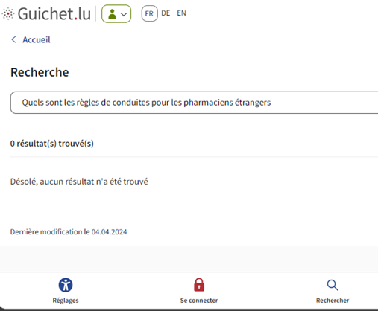
Existing search functionalities fail at capturing the meaning of the user query
Poor user experience
Search queries like "Quels sont les règles de conduite pour les pharmaciens étrangers" returns 0 result on Guichet.lu, despite relevant information being available on the platform
0
No understanding of the query
No understanding of the real semantic meaning of the user query
Current solutions fail to manage multilingual content or understand the semantic nuances of queries mixing multiple languages, leading to poor user experience
No Multilingual, context-aware search

Slide 4



A semantic search solution enhances user experience by improving accuracy, speed, and multilingual capabilities
Results
Models
User Impact
Context-aware search and retrieve
Scalable deployment: Docker with CI/CD enables rapid deployment in under 5 minutes
Text embedding models:
Hybrid search: Vector Search & BM25
Semantic search combined with Keywords search
Faster Response
Better precision and recall on the responses
Increased user experience
Better access the information by the user

Slide 5






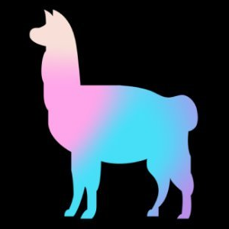


A robust and specialized technical stack to support natural language queries
1x Senior Data Scientist (6 months) 1x Expert Developer (6 months) 1x Expert Data Engineer (6 months)
ChromaDB Django Flutter GPT Hugging Face JupyterLab LangChain LlamaIndex LLM (Large Language Model) NLP (Natural Language Processing) Pinecone Streamlit

